Slide 1
Picture Talk
Using pictures to make claims: what conclusions can you draw from the picture? What evidence in the picture supports these conclusions?

Slide 2
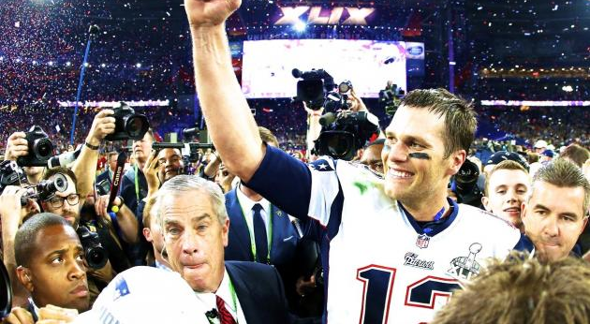
Sample Picture

Slide 3
Claim: Super Bowl Champion Celebrating
Claims made for the picture WITH background knowledge:
Tom Brady
2015 Super Bowl victory

Slide 4
Claims NOT supported by the picture
Football is a dangerous sport.
Sports are too competitive.
The Green Bay Packers should have went to the Super Bowl.

Slide 5
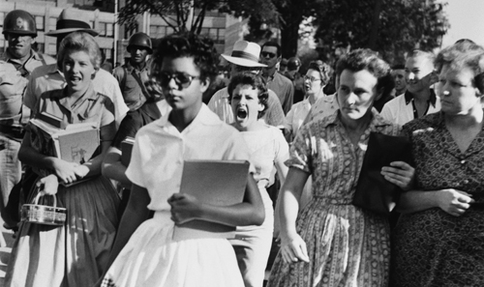

Slide 6
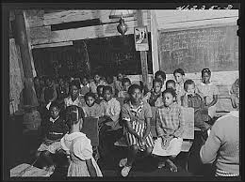

Slide 7
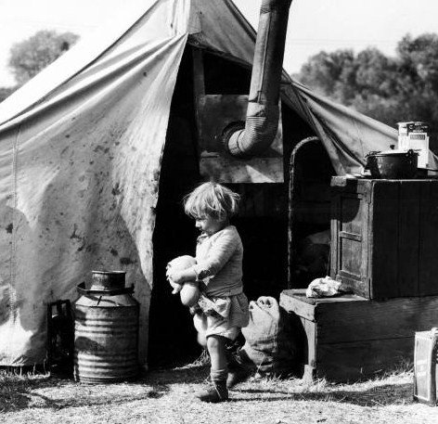

Slide 8
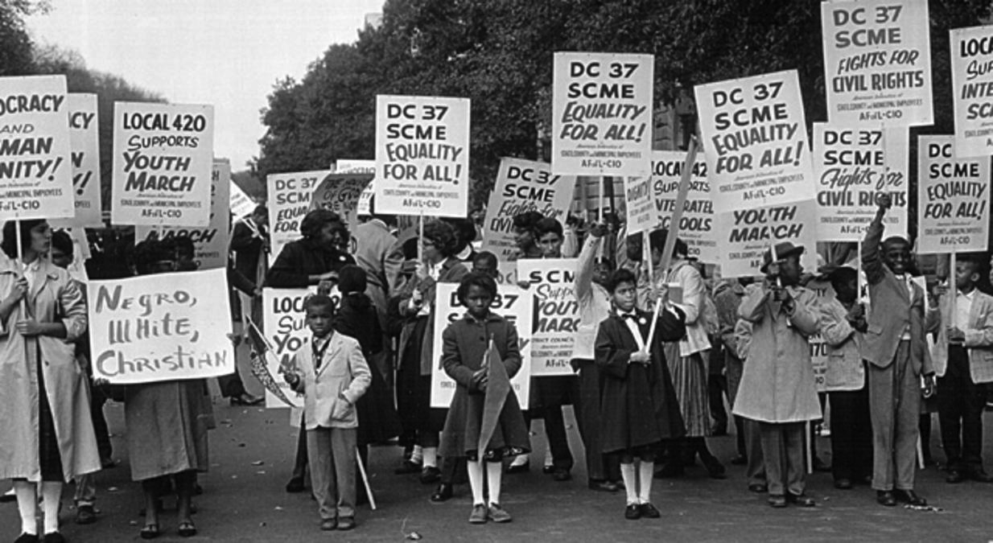

Slide 9
What is the point of this?
Helps us to make claims and back them up with evidence
Helps to prepare you for making inferences when READING
Take a closer look at the time periods we have been talking about
  1930s (I Know Why the Caged Bird Sings)
  1950s-60s (MLK Jr.)

